Slide 1

caGrid Metadata
caGrid / Novartis Workshop
Rockville, MD
June 22nd-26th , 2009

Slide 2
Interoperability
The ability of multiple systems to exchange information and to be able to use the information that has been exchanged.
Semantic interoperability
Syntactic interoperability

Slide 3
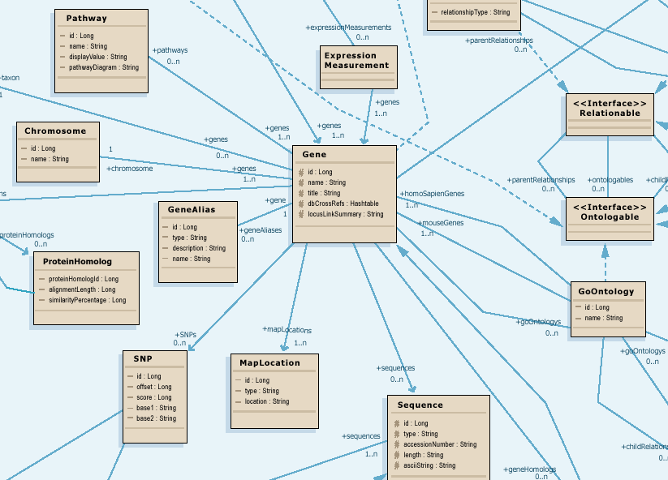
Modeling for Interoperability
Class diagram models target domain
Logical model is basis for semantic integration
Focus on attributes and relationships of domain objects

Slide 4
Data Model Meaning
What do all those data classes and attributes actually mean, anyway?
Data descriptors or “semantic metadata” required
Computable, commonly structured, reusable units of metadata are “Common Data Elements” or CDEs

Slide 5
Why do you need semantic metadata?
Class/ Attribute | Example Object Data | CIA Metadata | NCI Metadata
Agent |  | A sworn intelligence agent; a spy | Chemical compound administered to a human being to treat a disease or condition, or prevent the onset of a disease or condition
Agent.nSCNumber | 007 | Identifier given to an intelligence agent by the National Security Council | Identifier given to chemical compound by the US Food and Drug Administration Nomenclature Standards Committee
Agent.name | Taxol | CIA code name given to intelligence agents | Common name of chemical compound used as an agent

Slide 6
Computable Interoperability
Agent
C1708
Drug
C1708
name
id
nSCNumber
C1708:C41243
NDCCode
CTEPName
approvalDate
FDAIndID
approver
IUPACName
fdaCode
C1708:C41243
My model
Your model

Slide 7
Using caGrid to for Semantic Interoperability

Slide 8
Using caGrid to for Semantic Interoperability
In this Lesson, we will cover use of caGrid Services for the use case:
A researcher is trying collect information on proteins for a human BRCA1 gene.
There will be a demo where we use caGrid Metadata services
Source code will be provided for modification

Slide 9
Outline
Background
A Scientific User Scenario
caBIG™ Translation of the User Scenario
caGrid Services In Action
Conclusion
Notes:
9

Slide 10
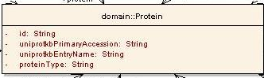
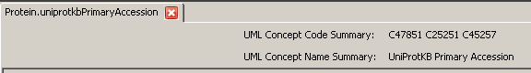
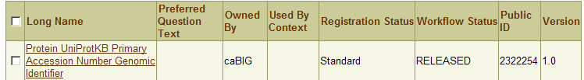
Background: Metadata Overview
UML Modeling
UML Class/attribute
EVS Concept Codes
Semantic Annotation using EVS concepts
CDE Public ID/version
CDE Long Name
caDSR Load/CDE Creation
Notes:
10
You will see in the afternoon and heard in Silver Level Compatibility
Every system needs to have a UML model descriptive enough
All the attributes and classes for this system is annotated using terms/concepts from Enterprise Vocabulary System
The information model is registered in cancer data standards reporsitory and transformed to common data elements.
For now consider each class/attribute/data type tuple corresponds to a CDE. Each CDE has a public ID.

Slide 11
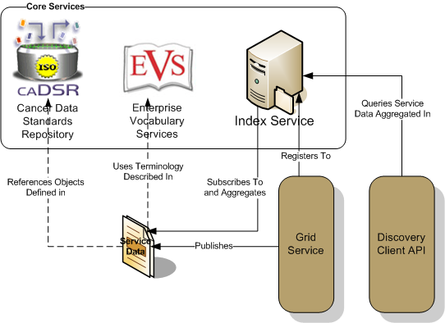
Background: caGrid Infrastructure
All the metadata is exposed via caGrid core service APIs:
EVS: Vocabularies/concepts
caDSR: Model Components/Common Data Elements
Index Service: Service metadata including annotated domain model to discover services
Notes:
EVS – What vocabularies are available? What is the concept code for a “term”? What synonyms for this term?
caDSR – What are the classes/attributes/associations registered for service X? What are the CDEs for service X?
Index Service – What is the model exposed? Where the service is located? What is the end-point for the service? It is the yellow pages for caGrid

Slide 12
A Scientific User Scenario
A researcher is studying human BRCA1 gene and wants to find information available in public resources on protein encoded by this gene
Notes:
12

Slide 13
A Scientific User Scenario – Details
A researcher is studying human BRCA1 gene and wants to find information available in public resources on protein encoded by this gene.
Reading carefully:
Multiple “resources”
“Gene” and “Protein” concepts
A specific “human” gene with name “BRCA1”
Notes:
13
How can one find multiple resources?
How can one find info on things like “Gene”/”Protein”?
How can one query resources with restrictive criteria?

Slide 14
caBIG™ Translation of the User Scenario
Discover caGrid Data Services providing Protein information
Use caGrid Discovery Client
Find how to combine the information from these Data Services
Find semantically equivalent data elements (Common Data Elements) from different data services
Identify/query the Protein corresponding to BRCA1 gene
Run caBIG™ Query Language (CQL) queries using caGrid Data Service Client
Collect information on the same protein from different resources
Run multiple or federated CQL queries against different Data Services leveraging Common Data Elements
Notes:
14

Slide 15
Discover caGrid Data Services providing protein information
Some possible ways to use caGrid Discovery Client:
Search by “search string” “Protein”
Not specific enough: Service descriptions may mention “Protein”
Search by EVS Concept Code for “Protein”
Code usually more specific: Less likely to find service description that contain an EVS Concept Code “C99999”
Notes:
15

Slide 16
Find EVS concept code for Protein
EVSGridServiceClient client=new EVSGridServiceClient(serviceURL_EVS);
//set search parameters for EVS query
EVSDescLogicConceptSearchParams evsSearchParams = new EVSDescLogicConceptSearchParams();
//set vocabulary to be used
evsSearchParams.setVocabularyName("NCI_Thesaurus");
evsSearchParams.setSearchTerm(“Protein”);
evsSearchParams.setLimit(10);
DescLogicConcept[] descLogicConcepts = client.searchDescLogicConcept(evsSearchParams);
Notes:
We are using EVSGridServiceClient (you will see in Session 3)

Slide 17
Find EVS concept code for Protein
ant runcaGridSemanticDemo -Dstep=step1 –Dterm=protein

Slide 18
Discover caGrid Data Services providing protein information
//instantiate a client
DiscoveryClient client = new DiscoveryClient(serviceURL_Index);
//search services end point exposing a model annotated concept code
EndpointReferenceType[] endPointReferenceArr=
client.discoverDataServicesByModelConceptCode(“C17021”);
Notes:
We are using DiscoveryClient to interact with Index Service and discover a service for a given criteria. It is a “Concept Code” in this case.

Slide 19
Discover caGrid Data Services providing protein information
ant runcaGridSemanticDemo -Dstep=step2 –Dterm=protein
Pick two services for next step

Slide 20
Find how to combine the information from these Data Services
DataServiceClient client_caBIO=new DataServiceClient(serviceURL_caBIO);
DataServiceClient client_gridPIR=new DataServiceClient(serviceURL_gridPIR);
//Download domain models from Data Services
DomainModel domainModel_caBIO;
DomainModel domainModel_gridPIR;
domainModel_caBIO=MetadataUtils.getDomainModel(client_caBIO.getEndpointReference());
domainModel_gridPIR=MetadataUtils.getDomainModel(client_gridPIR.getEndpointReference());
}
Notes:
Retrieve the model exposed by services.

Slide 21
Find how to combine the information from these Data Services
Find semantically equivalent attributes using Common Data Elements (CDEs)
//Parse all the Data Elements from first model (NOT SHOWN)
//Parse all the Data Elements from second domain model and return common CDEs
umlClassArr=exposedUMLClassCollection2.getUMLClass();
for (int i=0;i<umlClassArr.length;i++){
UMLClassUmlAttributeCollection attributeCollection = (UMLClassUmlAttributeCollection) umlClassArr[i].getUmlAttributeCollection();
UMLAttribute [] umlAttributeArr=attributeCollection.getUMLAttribute();
for (int j=0;j<umlAttributeArr.length;j++){
MyDataElement dataElement=
new MyDataElement(umlClassArr[i],umlAttributeArr[j]);
if(dataElementMap.containsKey(dataElement.getPublicIDVersion())){
MyDataElement sourceDataElement=
(MyDataElement)dataElementMap.get(dataElement.getPublicIDVersion());
MyDataElementMap myDataElementMap=new MyDataElementMap(sourceDataElement,dataElement);
commonDataElementList.add(myDataElementMap);
}
}
}
Notes:
DON’T READ IT. Just to prove it is programmatically possible to do so.
Get an intersection of two models and find semantically equivalent attributes using Common Data Elements (CDEs).

Slide 22
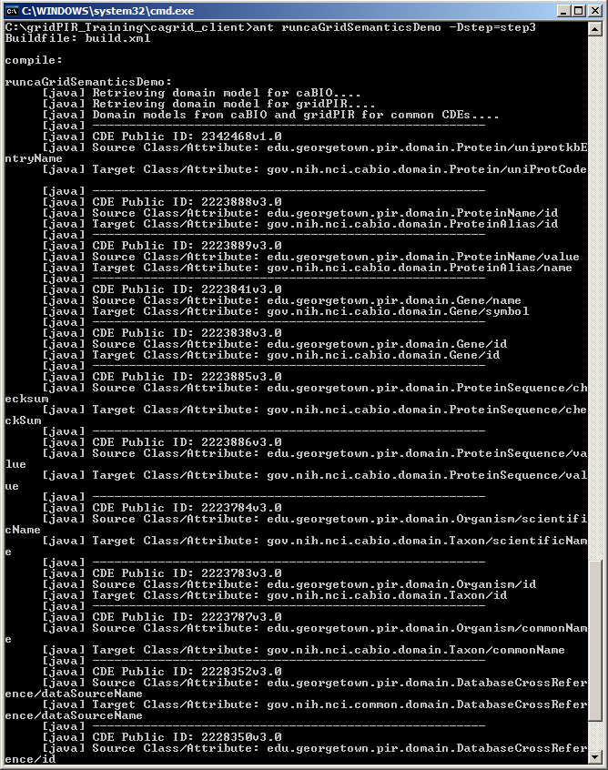
Find how to combine the information from these Data Services
ant runcaGridSemanticDemo -Dstep=step3
gridPIR’s Gene.name and caBIO’s Gene.symbol are semantically equivalent
Notes:
More on next slide….

Slide 23
Find how to combine the information from these Data Services
CDE: 2223841v3.0
gridPIR
caBIO
CDE: 2342468v1.0
Find semantically equivalent attributes using Common Data Elements (CDEs)

Slide 24
Identify/query the protein corresponding to BRCA1 gene
<?xml version="1.0" encoding="UTF-8"?>
<ns1:CQLQuery xmlns:ns1="http://CQL.caBIG/1/gov.nih.nci.cagrid.CQLQuery">
<ns1:Target name="edu.georgetown.pir.domain.Protein">
<ns1:Group logicRelation="AND">
<ns1:Association name="edu.georgetown.pir.domain.Gene" roleName="geneCollection">
<ns1:Attribute name="name" predicate="EQUAL_TO" value="brca1"/>
</ns1:Association>
<ns1:Association name="edu.georgetown.pir.domain.Organism" roleName="organismCollection">
<ns1:Attribute name="scientificName" predicate="EQUAL_TO" value="homo sapiens"/>
</ns1:Association>
</ns1:Group>
</ns1:Target>
</ns1:CQLQuery>
Notes:
We are using caBIG Query Language (you will see in Session 3)

Slide 25
Identify/query the protein corresponding to BRCA1 gene
DataServiceClient client_gridPIR=new DataServiceClient(serviceURL_gridPIR);
CQLQuery query_gridPIR = (CQLQuery) Utils.deserializeObject(
new StringReader(
"<ns1:CQLQuery xmlns:ns1=\"http://CQL.caBIG/1/gov.nih.nci.cagrid.CQLQuery\">"+
"<ns1:Target name=\"edu.georgetown.pir.domain.Protein\">"+
…….
"</ns1:Target>"+
"</ns1:CQLQuery>"
),
CQLQuery.class
);
CQLQueryResults results_gridPIR=client_gridPIR.query(query_gridPIR);
Notes:
We are using DataServiceClient (you will see in Session 3)

Slide 26
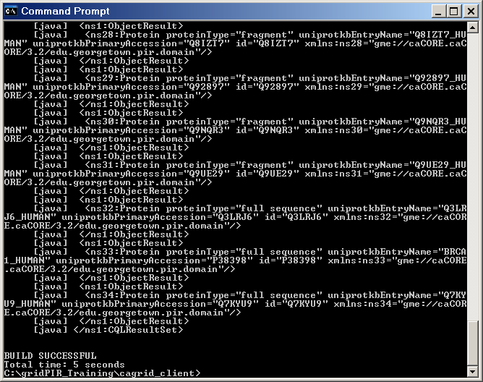
Identify/query the protein corresponding to BRCA1 gene
ant runcaGridSemanticDemo -Dstep=step4
Protein Object with uniprotkbEntryName BRCA1_HUMAN

Slide 27
Collect information on the same protein from different resources
We know
“Protein.uniprotCode” in caBIO is semantically equivalent to “Protein.uniprotkbEntryName” in gridPIR :
“BRCA1_HUMAN” protein from gridPIR corresponds to Human BRCA1 Gene
gridPIR
caBIO
CDE: 2342468v1.0
Notes:
What we know so far?

Slide 28
Collect information on the same protein from different resources
caBIO
Genomic Info
Join caBIO and gridPIRand access to more info
gridPIR
Annotations
Notes:
Use two differently named attributes to “join”/intersect two different models to gather more information.

Slide 29
Collect information on the same protein from different resources
caBIO
<ns1:CQLQuery xmlns:ns1="http://CQL.caBIG/1/gov.nih.nci.cagrid.CQLQuery">
<ns1:Target name="gov.nih.nci.cabio.domain.NucleicAcidSequence">
<ns1:Association name="gov.nih.nci.cabio.domain.Gene" roleName="geneCollection">
<ns1:Association name="gov.nih.nci.cabio.domain.Protein" roleName="proteinCollection">
<ns1:Attribute name="uniProtCode" predicate="EQUAL_TO" value="brca1_human"/>
</ns1:Association>
</ns1:Association>
</ns1:Target>
</ns1:CQLQuery>

Slide 30
Collect information on the same protein from different resources
gridPIR
<ns1:CQLQuery xmlns:ns1="http://CQL.caBIG/1/gov.nih.nci.cagrid.CQLQuery">
<ns1:Target name=“edu.georgetown.pir.domain.ZincFingerRegion">
<ns1:Association name="edu.georgetown.pir.domain.Protein" roleName=“proteinCollection">
<ns1:Attribute name="uniprotkbEntryName" predicate="EQUAL_TO" value="brca1_human"/>
</ns1:Association>
</ns1:Target>
</ns1:CQLQuery>

Slide 31
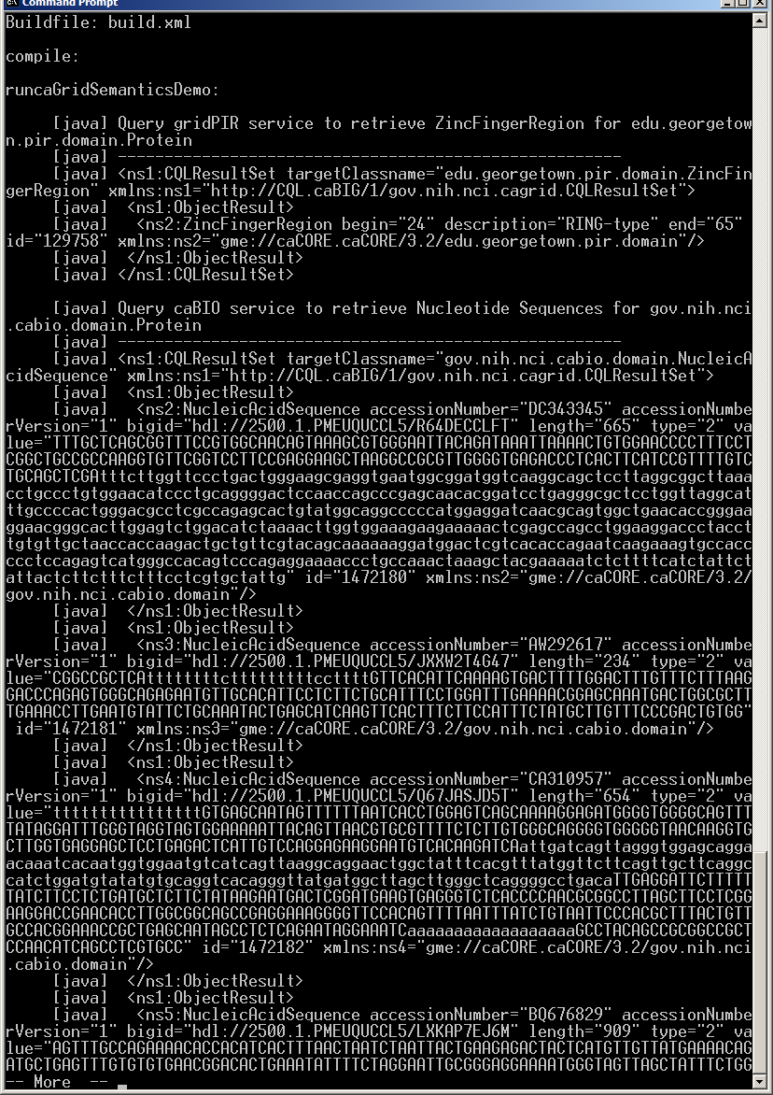
Collect information on the same protein from different resources
ant runcaGridSemanticDemo -Dstep=step5
Zinc Finger Region from gridPIR
Nucleic Acid Sequence from caBIO

Slide 32
Conclusion
Using caBIG™ silver level compatible caGrid Services supported by semantic metadata, one can:
Discover information resources (Standard Vocabularies) – Semantic annotation is important
Query resources using a standard language CQL (Standard APIs) – API/model correspondence is important
Identify ways to combine information from multiple resources (CDEs) – CDE reuse is very important
Notes:
32
See how the guidelines and steps in demo are related.

Slide 33
Session 0: UML Basics Why Model?
Modeling achieves four aims:
Helps you visualize a system
Permits you to specify the structure or behavior of a system
Guides you in constructing a system
Documents the decisions you have made
Build models of complex systems because they are difficult to comprehend in their entirety
Build models to better understand the system you are developing.
The caBIG™ process and architecture is model driven, it is required for interoperability and silver level compliance.
Notes:
Why model?
Short answer is it is absolutely required and the first step in the caCORE process is to draw your system/project domain in UML. * The model, when semantically annotated and combined with service metadata becomes the foundation that allows the grid and grid services to programmatically discover and combine relevant information from different data services. This has to be done early and well and updated as you update your data service
Remember the model is not just for your application but for interoperability with others.
In addition is helps by
Helps you visualize a system
Permits you to specify the structure or behavior of a system
Guides you in constructing a system
Documents the decisions you have made
Additional reasons are:
Build models of complex systems because they are difficult to comprehend in their entirety
Build models to better understand the system you are developing.
The caBIG process and architecture is model driven, it is required for interoperability and silver level compliance
There are three parts to the system model: the logical model, data model, and data mapping model. The logical model describes the target domain and should be created in the logical package.* The Data Model describes the database schema* and the Object relational mapping maps classes to object. All of these are drawn in UML. Throughout this presentation, the terms “logical model”, “domain model” and “object model” are used interchangeably.*
caCORE SDK tools impose modeling guidelines* such as
Java naming conventions*
Package rules*
Element constraints*
For Example, *
*Only UML class diagram elements may be used
*Cannot use interface, object, etc.
Detailed instructions on creating diagrams in UML can be found in the SDK Programmer’s Guide.

Slide 34
Session 0: UML Basics What is UML?
UML is a language for
Visualizing
Specifying
Constructing
Documenting
The artifacts of a software system.
UML allows you to build models that are precise, unambiguous and complete
There are many UML diagram types
caCORE SDK utilizes one type, the UML Class Diagram
Notes:
Visualizing: Communicating conceptual models to others is prone to error unless everyone involved speaks the same language. There are things about a software system you can’t understand unless you build models. An explicit model facilitates communication.
Specifying: UML allows you to build models that are precise, unambiguous and complete. There are many UML diagram types. caCORE utilizes one diagram type: UML Class Diagram
Constructing: UML models can be directly connected to a variety of programming languages. Maps to Java, C++, Visual Basic, etc. Tables in a RDBMS or persistent store in an OODBMS Permits forward engineering Permits reverse engineering
Documenting: The UML addresses documentation of system architecture, requirements, tests, project planning, and release management.
There are many UML diagram types, however caCORE utilizes one diagram type – the UML Class Diagram
Throughout this presentation we only talk about the logical model the most critical one to get right for caBIG , the terms “logical model”, “domain model” and “object model” are used interchangeably.*

Slide 35
Session 0: UML Basics UML Documenting
UML can be used to document of system architecture, requirements, tests, project planning, and release management.
CaBIG requires only class diagrams for a logical model.
Use Case Diagram
Deployment Diagram
- À©µµ¿ì 95 : Å¬¶óÀÌ¾ðÆ®
ºÐ»ê È¯°æÀÇ ÇÏµå¿þ¾î¹× ³×Æ®¿÷À¸·ÎÀÇ Á¤º¸ ½Ã½ºÅÛ ¿¬°á ¸ðµ¨
- À©µµ¿ì NT: ÀÀ¿ë¼­¹ö
- À¯´Ð½º ¸Ó½Å: ÀÀ¿ë ¼­¹ö ¹× µ¥ÀÌÅ¸ ¼­¹ö, Åë½Å ¼­¹ö
- IBM ¸ÞÀÎÇÁ·¹ÀÓ: µ¥ÀÌÅ¸ ¼­¹ö, Åë½Å ¼­¹ö
Use Case 1
Window95
Windows95
Windows95
¹®¼­°ü¸®
Å¬¶óÀÌ¾ðÆ®.EXE
Windows
¹®¼­°ü¸® ¾ÖÇÃ¸´
Actor A
Use Case 2
Actor B
NT
Solaris
¹®¼­°ü¸® ¿£Áø.EXE
Alpha
Windows
ÀÀ¿ë¼­¹ö.EXE
UNIX
Use Case 3
NT
IBM
Mainframe
µ¥ÀÌÅ¸º£ÀÌ½º¼­¹ö
mainWnd
fileMgr :
document :
gFile
repository
FileMgr
DocumentList
Document
user
FileMgr
Document
add( )
name : int
fetchDoc( )
delete( )
docid : int
Æ¯Á¤¹®¼­¿¡ ´ëÇÑ º¸±â¸¦
1: Doc view request ( )
sortByName( )
get( )
numField : int
read() fill the
»ç¿ëÀÚ°¡ ¿äÃ»ÇÑ´Ù.
open( )
code..
2: fetchDoc( )
close( )
FileList
fList
read( )
sortFileList( )
3: create ( )
add( )
create( )
fillDocument( )
delete( )
1
4: create ( )
5: readDoc ( )
1
È­ÀÏ°ü¸®ÀÚ´Â ÀÐ¾î¿Â
6: fillDocument ( )
¹®¼­ÀÇ Á¤º¸¸¦ ÇØ´ç ¹®¼­
°´Ã¼¿¡ ¼³Á¤À» ¿äÃ»ÇÑ´Ù.
7: readFile ( )
Repository
rep
File
È­¸é °´Ã¼´Â ÀÐ¾îµéÀÎ
8: fillFile ( )
(from Persistence)
read( )
GrpFile
°´Ã¼µé¿¡ ´ëÇØ ÀÌ¸§º°·Î
9: sortByName ( )
name : char * = 0
º¸¿©ÁØ´Ù.
Á¤·ÄÀ» ½ÃÄÑ È­¸é¿¡
readDoc( )
read( )
readFile( )
open( )
create( )
fillFile( )
Sequence Diagram
Class Diagram
Notes:
UML addresses documentation of system architecture, requirements, tests, project planning, and release management.
Example UML diagrams include:
Use Case Diagrams
Deployment Diagrams
Sequence Diagrams
Class Diagrams
As stated before, caCORE utilizes only the class diagrams which will be the focus of our training today.

Slide 36
Session 0: UML Basics How are caBIG™ models different?
caBIG™ services are expected to have a domain information model:
A Domain Information Model is a representation of our understanding of an area of knowledge
A Domain Information Model consists of ‘Classes’ that represent ‘things’ in the real world
In a Domain Information Model, classes contain ‘attributes’ that are characteristics of different instances of things in the real world

Slide 37
Cancer Data Standards Repository (caDSR)
UML Class | caDSR Data Element
Class | Object Class
Attribute | Property
Datatype (of the attribute) | Value Domain
data element
concept
representation
term
ISO/IEC 11179 compliant Data Element Concepts
Cancer Data Standards Repository (caDSR) is the database and tools used to house the metadata from caBIG® UML models.
UML Class Diagrams form the basis for creating and registering semantically unambiguous caDSR metadata
In the caDSR, a data element corresponds to the combination of a semantically annotated class attribute.
Notes:
37
caBIG relies on the metadata housed in caDSR for interoperability.
The class/attribute combination forms the Data Element Concept. The class attribute datatype is represented as a Value Domain.

Slide 38

Cancer Data Standards Repository (caDSR)
UML Class
caDSR Data Element
Gene
Gene Name java.lang.String
- name: String
Gene Name
Gene
Name
java.lang.String
string
ISO/IEC 11179 compliant Data Element
Notes:
38
The ISO 11179 metamodel provides a very rich metadata model to use for semantic integration and semantic surfing later on

Slide 39
Discovery API Client - Methods
Searches based on service level metadata
E.g. discoverServicesByResearchCenter
Searches based on semantic annotation
E.g. discoverDataServicesByModelConceptCode
Searches based on operation metadata (for analytical services)
E.g. discoverServicesByOperationName
Searches based on information model metadata (for data services)
E.g. discoverDataServicesByExposedClass
Searched based on XPath leveraging Service Metadata XML
discoverByFilter (String xpathPredicate)
Notes:
Examples give me all services hosted by Lombardi Comprehensive Cancer Center
Examples give me all services providing Gene information
Examples who is exposing a certain class

Slide 40
Discovery API Client – Discovering services using a keyword
//Index service on production caGrid
String serviceURL="http://cagrid-index.nci.nih.gov:8080/wsrf/services/DefaultIndexService";
// create a DiscoveryClient instance
DiscoveryClient client = new DiscoveryClient(serviceURL);
//discover services by keyword
EndpointReferenceType[] endPointReferenceArr = client.discoverServicesBySearchString(“Protein”);
//list URLs for returned services
for (int i=0; i < endPointReferenceArr.length; i++){
System.out.println("Address: "+endPointReferenceArr[i].getAddress());
}
Notes:
As any other service API client needs an instance needs to be created

Slide 41
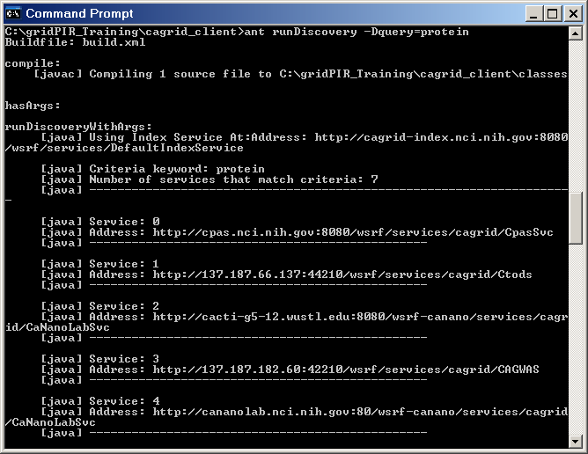
Discovery API Client – Discovering services using a keyword
Result:

Slide 42
Metadata API - MetadataUtils
Used to access and manipulate instances of service metadata
Complements the Discovery API;
Once a service is discovered MetadataUtils’s methods can be used to access and inspect the full metadata for the service

Slide 43
Metadata API – MetadataUtils Methods
Retrieves the service metadata or domain model from the specified service.
getServiceMetadata
Writes/reads the XML representation of the service metadata to/from the specified writer/reader:
serializeServiceMetadata
deserializeServiceMetadata
Writes/reads the XML representation of the domain model to/from the specified writer/reader:
serializeDomainModel
deserializeDomainModel
Notes:
Domain model can be retrieved from caDSR as well. However Metautils helps accessing the really exposed model. Same model can be used by many services.

Slide 44
Metadata API – MetadataUtils - Example
//discover services by concept code used to annotate the model such as C17021 (Protein)
EndpointReferenceType[] endPointReferenceArr = client.discoverServicesByModelConceptCode(“C17021”);
for (int i=0; i < endPointReferenceArr.length; i++){
//retrieve service metadata for the service
ServiceMetadata serviceMetadata=MetadataUtils.getServiceMetadata(endPointReferenceArr[i]);
//print host center information
System.out.println("Hosting Center: "+serviceMetadata.getHostingResearchCenter().getResearchCenter().getDisplayName());
//retrieve domain model for the service
DomainModel domainModel=MetadataUtils.getDomainModel(endPointReferenceArr[i]);
//print domain model name
System.out.println("Domain Model/Project Short Name: "+domainModel.getProjectShortName());
System.out.println("Address: "+endPointReferenceArr[i].getAddress());
}

Slide 45
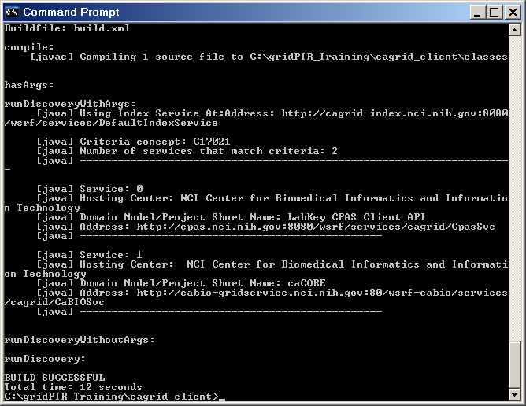
Metadata API – MetadataUtils - Example
Result:

Slide 46
https://cabig-kc.nci.nih.gov/CaGrid/KC/index.php/Using_caBIG_Infrastructure_to_Find_and_Retrieve_Grid_Data

Slide 47
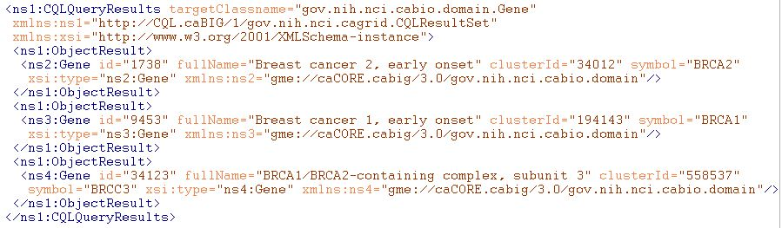
Example of Grid Data Syntax
XML of CQL Results from a query to a Data Service
Infrastructure capable of mapping directly back to corresponding programming language objects
Semantics of data are explicitly bound to the conceptual model (DomainModel) the user queried against, and implicitly associated with this XML via it’s namespace

Slide 48
Example Syntax Use Cases
I’m writing an application to process arbitrary data types, how do I know what the data will look like?
I want to build a grid service, how do I describe the inputs and outputs of its operations?
How can I be sure data I am getting is valid?
I don’t want to work with WSDL or XML, can’t I just use an object-oriented client API to talk to grid services?

Slide 49
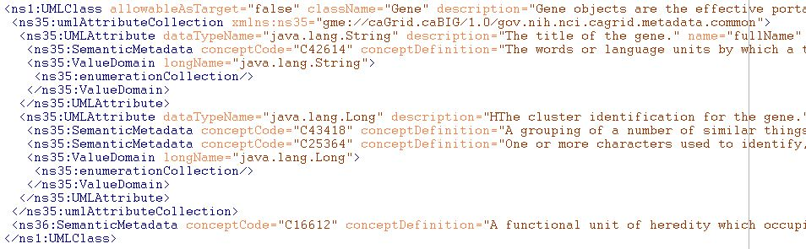
Example of Grid Data Semantics
Snippet of XML representation of DomainModel metadata from a Data Service
Describes the caDSR-registered logical structure, used to query the service; annotated with concept codes from EVS
Independent of the syntax used to realize the data types on the grid (such as in the results of a query)

Slide 50
Example Semantics Use Cases
What are the service addresses of all the running Data Services exposing data based on concept C16612?
What are the permissible values of Taxon.abbreviation in the caBIO 3.1 model?
Are there any Analytical Services on the grid which provide operations over a data type that is semantically interoperable with the caBIO 3.1 Tissue.organ?
How do I learn about the data available from an arbitrary Data Service?

Slide 51
Example Semantic/Syntax Binding Use cases
I’ve received a generic data set (such as a CQL results object), how can I understand the semantics of the contained data?
I want to describe a workflow using either logical models or EVS concepts, how can I figure out how the XML is structured such that I can use BPEL to extract data?
Better yet, is there a graphical tool that can do the transformation for me?
I registered my model in caDSR, why is Introduce asking me for XML Schemas?

Slide 52
Realizing the Binding Use Cases
Need the capability to formally describe, register, and access the association between a given data type’s syntax and semantics
The foundation of the grid data syntax is XML Schema; XML Schemas are identified by their namespaces
The foundation of the grid data semantics are the EVS annotated, caDSR data models; data models are identified by their caDSR identifier and version
The binding between syntax and semantics is essentially a mapping from the UML/caDSR universe to the XML/GME universe

Slide 53
Connecting UML and XML: Current Implementation
Previous “solution” was to require an XML Schema for each package that followed a namespace construction rule
Had several limitations:
Several caBIG projects wish to reuse existing XML Schemas, which have existing namespaces (can’t be changed for interoperability reasons)
Some uniqueness constraints assumed are not strictly enforced
Does not support “reverse lookup” (XSD -> caDSR)
Does not provide fine grain mapping necessary for some applications/infrastructure
Somewhat prescriptive (namespaces, naming conventions, etc) when ideal solution is entirely descriptive

Slide 54
Connecting UML and XML: The complexities
There are a large variety of options on how a conceptual UML model can be represented in XML (many in use within caBIG as well as relevant external XML standards)
Assumptions on namespaces or structure don’t work
Most applications/services “don’t care,” so process must be simple for the default case, but sufficient for the others
Names different
Attribute or element?
What about Collection associations
?

Slide 55
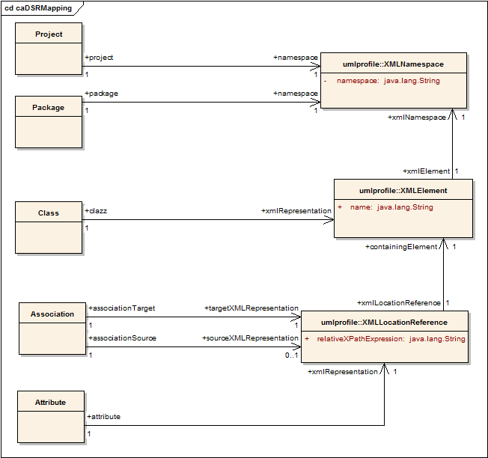
Connecting UML and XML: The solution
Planned definition of mapping rules specify how a given UML entity is represented in XML over the grid
Maintained in the caDSR, lookup and query available through caDSR grid service

Slide 56
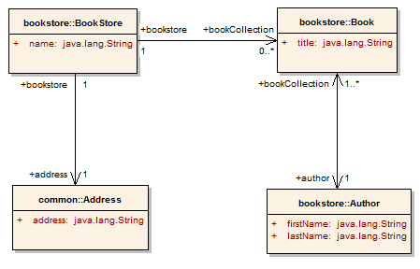
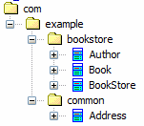
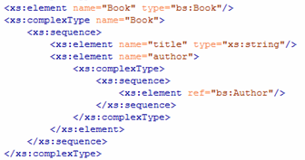
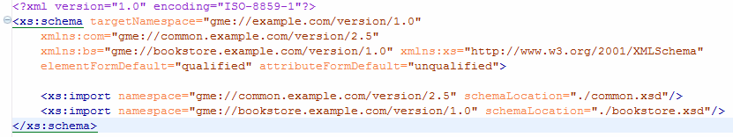
Partial Mapping Example
Project:
BookStore
Version:
1.0
Attribute Mapping
XPath:
title
Element:
Book
Namespace: gme://bookstore.example.com/version/1.0
Project’s Namespace (gme://example.com/version/1.0)

Slide 57
caGrid Service Metadata
Scott Oster (Scott.Oster@osumc.edu) - Ohio State University

Slide 58
Problem Statement
Achieving caBIG interoperability goals on the grid requires not only sound handling of both syntax and semantics, but also a formal binding between them
Previously, the binding was:
implicit and based upon overly constraining assumptions (in some cases)
difficult to make use of programmatically
difficult to verify, and therefore enforce, compliance with

Slide 59
Example of Grid Data Syntax
XML of CQL Results from a query to a Data Service
Infrastructure capable of mapping directly back to corresponding programming language objects
Semantics of data are explicitly bound to the conceptual model (DomainModel) the user queried against, and implicitly associated with this XML via it’s namespace

Slide 60
Example Syntax Use Cases
I’m writing an application to process arbitrary data types, how do I know what the data will look like?
I want to build a grid service, how do I describe the inputs and outputs of its operations?
How can I be sure data I am getting is valid?
I don’t want to work with WSDL or XML, can’t I just use an object-oriented client API to talk to grid services?

Slide 61
Example of Grid Data Semantics
Snippet of XML representation of DomainModel metadata from a Data Service
Describes the caDSR-registered logical structure, used to query the service; annotated with concept codes from EVS
Independent of the syntax used to realize the data types on the grid (such as in the results of a query)

Slide 62
Example Semantics Use Cases
What are the service addresses of all the running Data Services exposing data based on concept C16612?
What are the permissible values of Taxon.abbreviation in the caBIO 3.1 model?
Are there any Analytical Services on the grid which provide operations over a data type that is semantically interoperable with the caBIO 3.1 Tissue.organ?
How do I learn about the data available from an arbitrary Data Service?

Slide 63
Example Semantic/Syntax Binding Use cases
I’ve received a generic data set (such as a CQL results object), how can I understand the semantics of the contained data?
I want to describe a workflow using either logical models or EVS concepts, how can I figure out how the XML is structured such that I can use BPEL to extract data?
Better yet, is there a graphical tool that can do the transformation for me?
I registered my model in caDSR, why is Introduce asking me for XML Schemas?

Slide 64
Realizing the Binding Use Cases
Need the capability to formally describe, register, and access the association between a given data type’s syntax and semantics
The foundation of the grid data syntax is XML Schema; XML Schemas are identified by their namespaces
The foundation of the grid data semantics are the EVS annotated, caDSR data models; data models are identified by their caDSR identifier and version
The binding between syntax and semantics is essentially a mapping from the UML/caDSR universe to the XML/GME universe

Slide 65
Connecting UML and XML: Current Implementation
Previous “solution” was to require an XML Schema for each package that followed a namespace construction rule
Had several limitations:
Several caBIG projects wish to reuse existing XML Schemas, which have existing namespaces (can’t be changed for interoperability reasons)
Some uniqueness constraints assumed are not strictly enforced
Does not support “reverse lookup” (XSD -> caDSR)
Does not provide fine grain mapping necessary for some applications/infrastructure
Somewhat prescriptive (namespaces, naming conventions, etc) when ideal solution is entirely descriptive

Slide 66
Connecting UML and XML: The complexities
There are a large variety of options on how a conceptual UML model can be represented in XML (many in use within caBIG as well as relevant external XML standards)
Assumptions on namespaces or structure don’t work
Most applications/services “don’t care,” so process must be simple for the default case, but sufficient for the others
Names different
Attribute or element?
What about Collection associations
?

Slide 67
Connecting UML and XML: The solution
Planned definition of mapping rules specify how a given UML entity is represented in XML over the grid
Maintained in the caDSR, lookup and query available through caDSR grid service

Slide 68
Partial Mapping Example
Project:
BookStore
Version:
1.0
Attribute Mapping
XPath:
title
Element:
Book
Namespace: gme://bookstore.example.com/version/1.0
Project’s Namespace (gme://example.com/version/1.0)

Slide 69
Agenda
Service Overview
Metadata Infrastructure
Common Metadata Models
Portal Metadata Examples
Metadata-Driven Query Infrastructure
Lessons Learned

Slide 70
caGrid Community Involvement
caGrid itself provides no real data or analysis to caBIG™; its the enabling infrastructure which allows the community to do so
The real value of the grid comes from bringing this information to the end user
Community members develop end user applications which consume of the resources provided by the grid

Slide 71
What is a Community Provided caGrid Service?
Silver compatible systems are exposed to the Grid as caGrid Services
caDSR models are used for all data types, and transported over the grid in a common fashion
Standardized, common pattern and mechanism for remote access
Language and implementation technology independent
Common security infrastructure for authentication and authorization
Standardized service metadata models and metadata advertisement mechanisms
Community provided service types:
Data Services
Expose data to the grid in a unified way
Analytical Services
Expose analytical operations to the grid

Slide 72
caGrid Metadata Infrastructure Goals
Support a strongly typed grid
Syntactic and Semantic interoperability
Programmatic!
Smooth transition from Application to Grid and back
Leverage wealth of existing metadata
Enable service Advertisement and Discovery

Slide 73
Metadata Services
Cancer Data Standards Repository (caDSR)
caBIG projects register their data models as Common Data Elements (CDEs) which are semantically harmonized and then centrally stored and managed the caDSR
The caDSR grid service provides:
Model discovery and traversal
caGrid standard metadata generation capabilities
Enterprise Vocabulary Services (EVS)
EVS is set of services and resources that address the need for controlled vocabulary
The EVS grid service provides:
Query access to the data semantics and controlled vocabulary managed by the EVS
Global Model Exchange (GME)
GME is a DNS-like data definition registry and exchange service that is responsible for storing and linking together data models in the form of XML schema.
The GME grid service provides:
Access to the authoritative structural representation of data types on the grid
Globus Information Services: Index Service
The Globus Information Services infrastructure provides a generic framework for aggregation of service metadata, a registry of running Grid services, and a dynamic data-generating and indexing node, suitable for use in a hierarchy or federation of services
The Index grid service provides:
Yellow and white pages for the grid

Slide 74
caGrid Data Description Infrastructure
Client and service APIs are object oriented, and operate over well-defined and curated data types
Objects are defined in UML and converted into ISO/IEC 11179 Administered Components, which are in turn registered in the Cancer Data Standards Repository (caDSR)
Object definitions draw from controlled terminology and vocabulary registered in the Enterprise Vocabulary Services (EVS), and their relationships are thus semantically described
XML serialization of objects adhere to XML schemas registered in the Global Model Exchange (GME)

Slide 75
Advertisement and Discovery Overview
Advertisement:
The caGrid Grid Service Owner composes service metadata describing the service to the grid and publishes it to grid. The service metadata describes properties of the grid services that caGrid users and other grid services may query.
Discovery:
A caGrid Researcher specifies search criteria describing a service. The research submits the discovery request to a discovery service, which identifies a list of services matching the criteria, and returns the list to the researcher.

Slide 76
Advertisement and Discovery Process
All services register their address and metadata information to an Index Service
The Index Service subscribes to the standardized metadata and aggregates their contents
Clients can discover services using a discovery API which facilitates inspection of data types
Leveraging semantic information in EVS (from which service metadata is drawn), services can be discovered by the semantics of their data types

Slide 77
Service Discovery Process
Clients formulate a query over the caGrid standard metadata
Examples:
“Find me all the services from Ohio State’s Cancer Center”
“Which Analytical services take Genes as input?”
“Which Data services expose data relating to lung cancer?”
“Find me all the services with some metadata mentioning the string ‘macromolecules’”
This query is sent to the caGrid Index Service which returns the Address(es) of the services satisfying the query
The client can then further interrogate the satisfying services by asking for all of their metadata or service descriptions
Finally the client invokes the desired services as appropriate

Slide 78
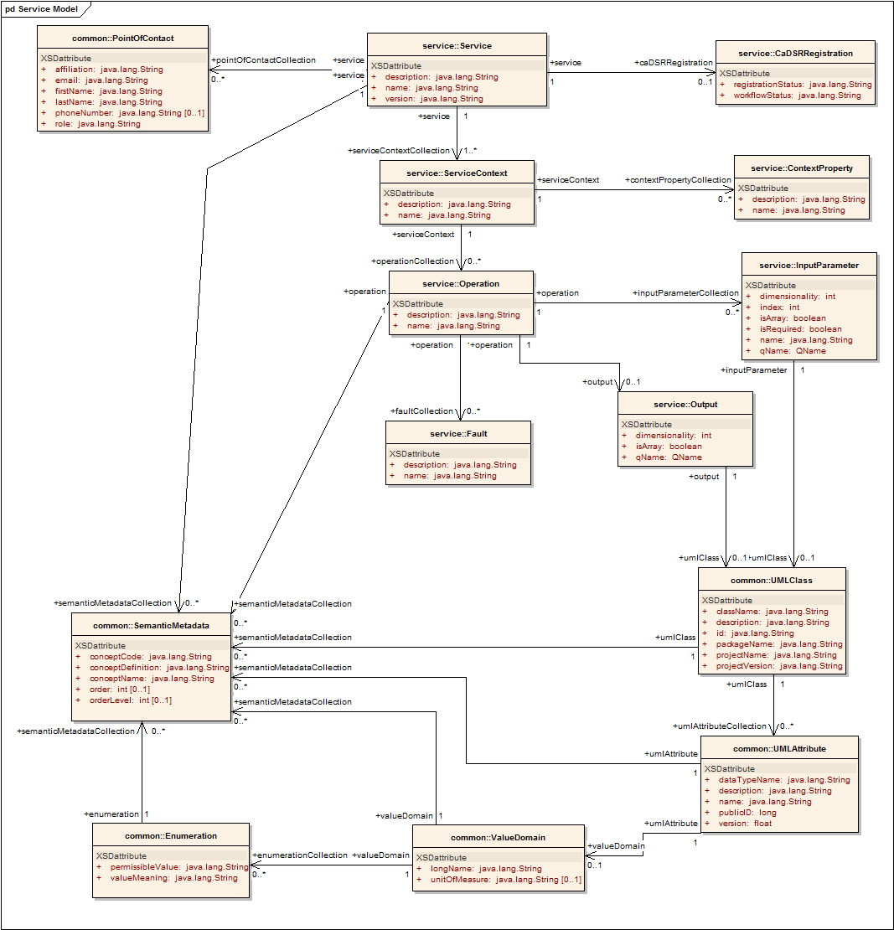
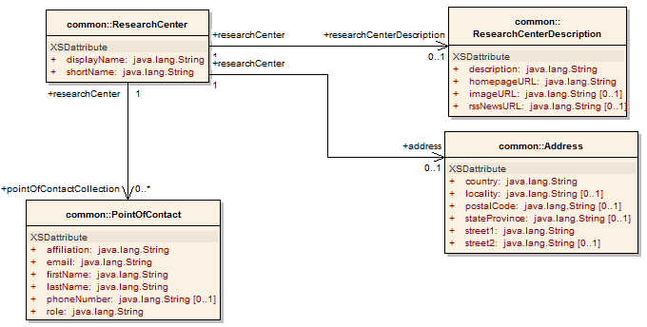
Service Metadata: Core Model
Common Service Metadata
Provided by all services
Details service’s capabilities, operations, contact information, hosting research center
Service operation’s inputs and outputs defined in terms of structure and semantics extracted from caDSR and EVS
Majority auto-generated by Introduce

Slide 79
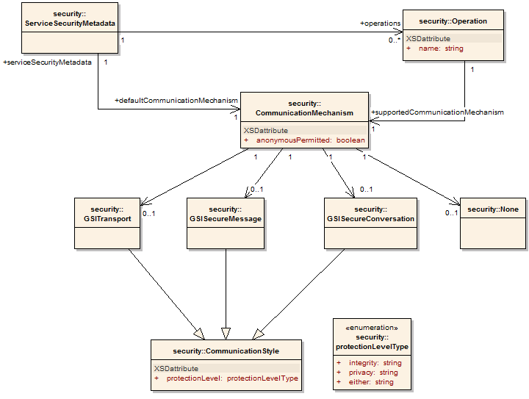
Service Metadata: Service Security
Service Security Metadata
Provided by all services
Details the service’s requirements on communication channel for each operation
Can be used by client to programmatically negotiate an acceptable means of communication
For example: Does operation X allow anonymous clients, or are credentials required?
Auto-generated by Introduce

Slide 80
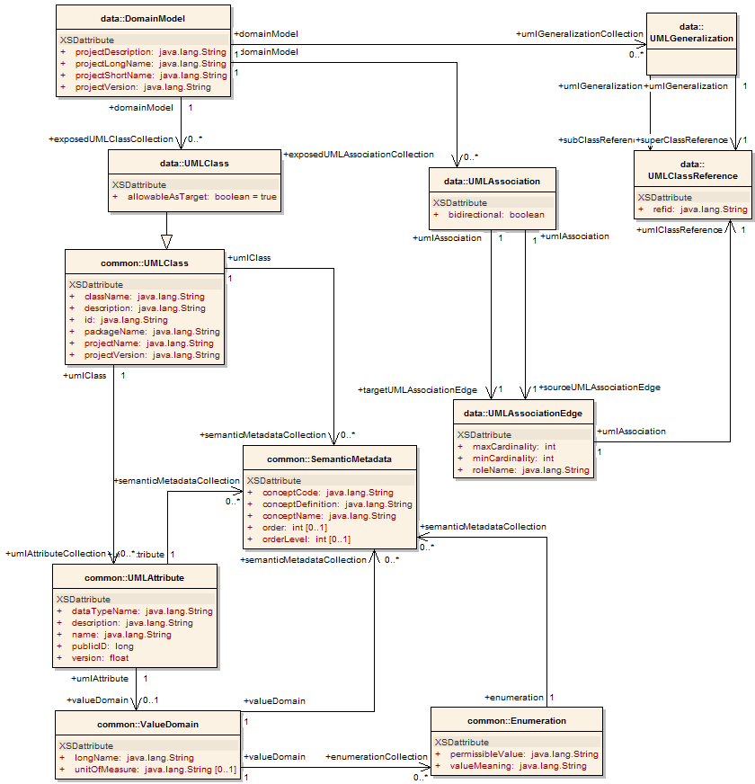
Service Metadata: Data Service
Data Service Metadata
Provided by all data services
Describes the Domain Model being exposed, in terms of a UML model linked to semantics
Provides information needed to formulate the Object-Oriented Query
As with common metadata, data types defined in terms of structure and semantics extracted from caDSR and EVS
Auto-generated by Introduce

Slide 81
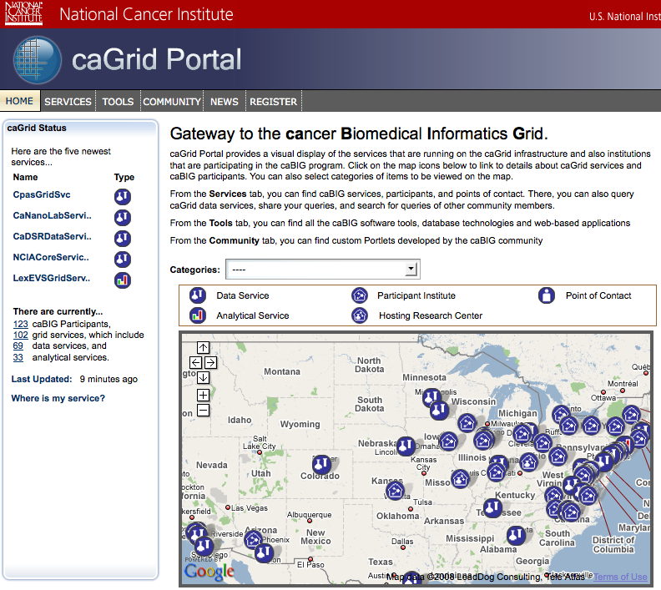
caGrid Portal: Service Map http://cagrid-portal.nci.nih.gov/
Google Maps integration enabled by Center Information in metadata
Recent services and categorization discovered from Index Service

Slide 82
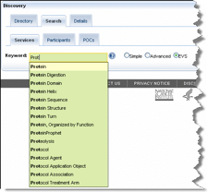
caGrid Portal: Metadata-driven Discovery
Structured discovery queries can be constructed over the metadata model
Keyword expansion with information from the controlled terminology available via the EVS

Slide 83
caGrid Portal: Service Details
Each discovered service’s metadata can be perused
Federated queries can be constructed graphically from auto-discovered potential semantic joins

Slide 84
Federated Query Processor
Provides a mechanism to perform basic distributed aggregations and joins of queries over multiple data services
As caGrid data services all use a uniform query language, CQL, the Federated Query Infrastructure can be used to express queries over any combination of caGrid data services
Federated queries are expressed with a query language, DCQL, which is an extension to CQL to express such concepts as joins, aggregations, and target services
Implemented as a stateful grid service, queries may be executed asynchronously and results retrieved at a later time
Supports secure deployments wherein result ownership is enforced
Coupled with semantic discovery capabilities of caGrid, provides a powerful framework for data discovery, mining, and integration

Slide 85
Lessons Learned
Applications leveraging metadata will proliferate…
Therefore, having a common “base model” is important
Therefore, plan to assert its authenticity
Therefore, consider future sources of information, and how to differentiate between them
You don’t know what your users will want to do tomorrow…
Therefore, design the model with extensibility in mind
Therefore, have a plan to decide what should be incorporated into a common/standard model and what is “application specific”
In distributed systems, aggregated information is always out of date…
Therefore, only capture information which you can reliably use out of date given your scalability and performance needs

Slide 86
Interoperability
The ability of multiple systems to exchange information and to be able to use the information that has been exchanged.
Semantic interoperability
Syntactic interoperability

Slide 87
SYNTACTIC
SEMANTIC
SEMANTIC
caBIG Compatibility Guidelines
SEMANTIC

Slide 88
Modeling for Interoperability
Class diagram models target domain
Logical model is basis for semantic integration
Focus on attributes and relationships of domain objects

Slide 89
Example UML Class Model

Slide 90
Data Model Meaning
What do all those data classes and attributes actually mean, anyway?
Data descriptors or “semantic metadata” required
Computable, commonly structured, reusable units of metadata are “Common Data Elements” or CDEs
NCI uses the ISO/IEC 11179 standard for metadata structure and registration

Slide 91
The ISO/IEC 11179 Standard
Specifies the kind and quality of metadata necessary to describe data, and it specifies the management and administration of that metadata in a metadata registry (MDR).
Applies to the formulation of data representations, concepts, meanings, and relationships between them, independent of the organization that produces the data.
Does NOT apply to the physical representation of data as bits and bytes at the machine level.
Provides the rules and guidelines for naming and identification of data elements. It defines the identifying attributes, describes the relationship of the attributes to each other and includes principles by which naming conventions can be developed.

Slide 92
ISO Terms and Definitions
Data Element: A unit of data for which the definition, identification, representation and permissible values are specified by means of a set of attributes
Data Element Concept: An idea that can be represented in the form of a data element, described independently of any particular representation
Data Element Representation: The part of a data element having a value domain, data type and other representational specifications
Representation Class: Classification of data elements based on the type of representational form
Conceptual Domain: A set of possible value meanings of a data element expressed without representation
Value Domain: A set of attributes describing representational characteristics of instance data with or without permissible values
Value Meaning: A member of the set of finite allowed inventory of notions that can be categorized for a conceptual domain
Permissible Value: An expression of a value meaning in a specific value domain

Slide 93
Cancer Data Standards Repository
Implementation of ISO/IEC 11179 Registry for Common Data Elements – units of semantic metadata
Client for Enterprise Vocabulary: metadata constructed from controlled terminology and annotated with concept codes
Binds the structural data objects to their underlying semantics
Precise specification of Classes, Attributes, Data Types, Permissible Values: Strong typing of data objects.
Tools:
UML Loader: automatically register UML models as metadata components
CDE Curation: Fine tune metadata and constrain permissible values with data standards
Form Builder: Create standards-based data collection forms
CDE Browser: search and export metadata components

Slide 94
Details of a Concept
Name
Code (Concept Unique Identifier)
Properties
Definition (s)
Synonym (s)
Preferred name: the term NCI recommends for use in written and oral communication
Links to use or related information in other, external resources, such as UMLS
Roles
Relationships with other concepts
Taxonomy / Hierarchy
Superconcepts / More General Concepts / Parents
Subconcepts / More Specific Concepts / Children

Slide 95

Enterprise Vocabulary Services (EVS)
Controlled vocabulary resources for cancer research community
Manages the concepts
NCI Thesaurus
NCI reference terminology (public domain, open source)
46,000 concepts covering agents, anatomy, biological processes, diseases, genes, gene products, and techniques/equipment
Built using description logic
Designed for application development: database coding, searching, and data mining
NCI Metathesaurus
Online dictionary and thesaurus
Adaptation of National Library of Medicine’s Unified Medical Language System (UMLS) Metathesaurus
930,000+ concepts; 2,200,000 terms and phrases
Built using lexical matching
Designed for term mapping and document indexing across vocabularies

Slide 96
What can EVS do?
Check and compare dictionary definitions
Find synonyms
Determine relationships to other concepts/terms
Identify and evaluate potential options when curating new CDEs or adding terms to permissible value lists
Provide links to related research publications

Slide 97
Why do you need semantic metadata?
Class/ Attribute | Example Object Data | CIA Metadata | NCI Metadata
Agent |  | A sworn intelligence agent; a spy | Chemical compound administered to a human being to treat a disease or condition, or prevent the onset of a disease or condition
Agent nSCNumber | 007 | Identifier given to an intelligence agent by the National Security Council | Identifier given to chemical compound by the US Food and Drug Administration Nomenclature Standards Committee
Agent name | Taxol | CIA code name given to intelligence agents | Common name of chemical compound used as an agent
Notes:
The segue from here is so how do we utilize this to provide semantic interoperability?

Slide 98
Computable Interoperability
Agent
C1708
Drug
C1708
name
id
nSCNumber
C1708:C41243
NDCCode
CTEPName
approvalDate
FDAIndID
approver
IUPACName
fdaCode
C1708:C41243
My model
Your model

Slide 99
Semantics Example
<Agent>
<name>Taxol</name>
<nSCNumber>007</nSCNumber>
</Agent>
Class/ Attribute | Example Data | CIA Definition | NCI Definition
Agent |  | A sworn intelligence agent; a spy | Chemical compound administered to a human being to treat a disease or condition, or prevent the onset of a disease or condition
Agent.nSCNumber | 007 | Identifier given to an intelligence agent by the National Security Council | Identifier given to chemical compound by the US Food and Drug Administration Nomenclature Standards Committee
Agent.name | Taxol | CIA code name given to intelligence agents | Common name of chemical compound used as an agent

